Slide 1
EmpowHer
EmpowHER: Empowering Girls for Corporate Excellence Soft Skill Curriculum Corporate Communication
Kanishka Nangia
AVP, Moody’s
16 years in IT Industry
Aug-2023

Slide 2
Agenda
Introduction – 5 Mins
The Communication Process – 10 Mins
Functions of Corporate Communication – 5 Mins
Benefits of Effective Communication – 10 Mins
Types of Communication in Organizations – 5 Mins
Barriers to Active Listening – 10 Mins
Using the Right Communication Medium – 5 Mins
Building a Communications Strategy – 5 Mins
Questions & Answers – 5 Mins

Slide 3

Introduction
Communication?
a process by which information is exchanged between individuals through a common system of symbols, signs, or behavior.
Corporate Communication
The process of sharing, exchanging, and transmitting information, ideas, and messages within an organization, including interpersonal, team, organizational, and external interactions.
Corporate communication is the way a company shares information and interacts with its employees, stakeholders, and the public.
Notes:
Talk about what communication is in general. What if communication is not there.
What is corporate communication from Employee and org perspective.

Slide 4
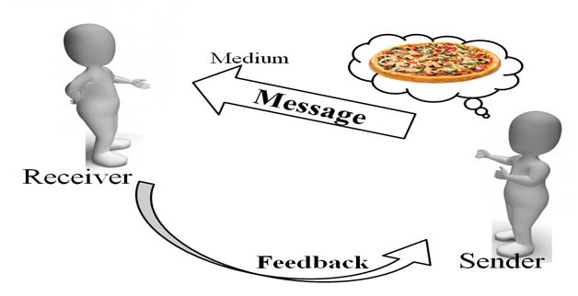
The Communication Process
Sender:
Message:
Channel:
Receiver:
Feedback:

Slide 5
Functions of Corporate Communication

Slide 6
Benefits of Effective Communication
Enhanced Productivity:
Improved Employee Engagement:
Reduced Stress:
Better Teamwork:
Greater Innovation
Conflict Resolution
Employee Satisfaction:

Slide 7
Types of Communication in Organizations
Internal Communication
Interpersonal Communication
Team Communication
Organizational Communication
External Communication

Slide 8
Active Listening and Its Barrier
What?
process of fully focusing, understanding, responding, and remembering what is being said
Barriers?
Distractions
Prejudices and Biases
Misinterpretation
Emotional Barriers
Information Overload:
Lack of Interest:
Interruptions:

Slide 9
Enhancing Communication
Using the Right Communication Medium
Building a Communications Strategy

Slide 10
Building a Communications Strategy
<repeat topic slides as required>

Slide 11
Questions & Answers
<repeat topic slides as required>

Slide 12
Thank You

Slide 13
Appendix
Add Links or permissible Images as needed

Slide 14
Appendix – Communication Matrix
Role | Medium of Communication | Person/Teams Communicated With
Software Developers | Email | Peers
Project Manager | Slack | HR
QA Analyst | Meetings | Project Managers
Business Analyst | Tools – Jira, Service Now | Clients
HR Manager | Video Conferencing | All Employees
Accountant | Phone | Leadership
CEO/Leadership | Informal Chats | External Vendors
Legal Team | Trainings | Investors
Compliance Officer |  | Regulatory Bodies
Regulatory Officer |  | Stake
Investor Relations Officer |  | Media
Marketing/PR Team |  | General Public
 |  | Support Teams

